Slide 1


TRIALS AND TRIBULATIONS
An ards LITERATURE REVIEW

Slide 2
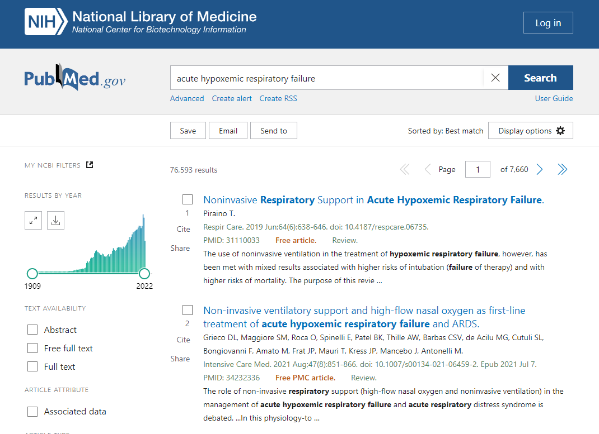

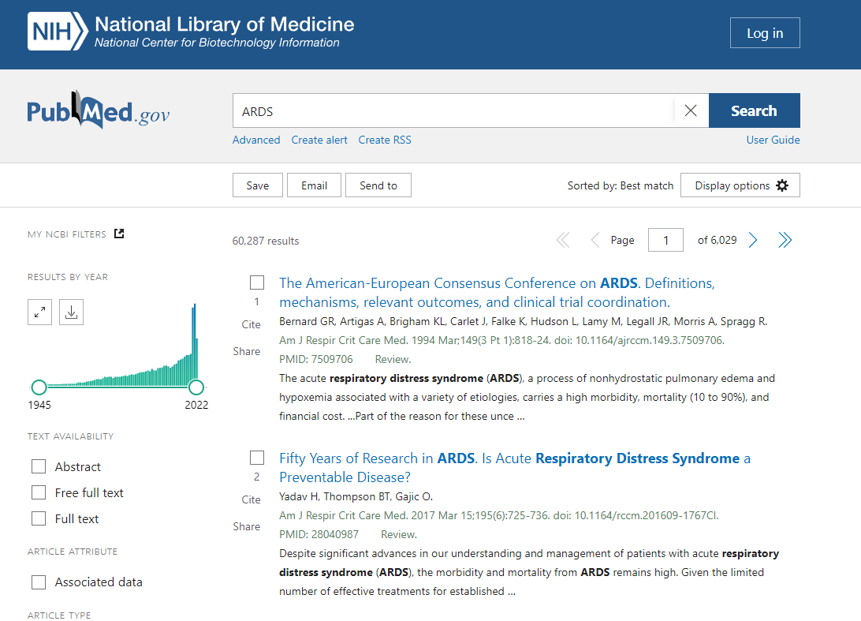

Slide 3
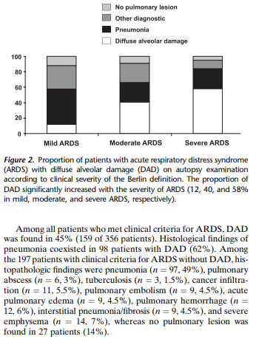
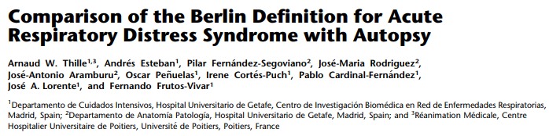
Why does this talk matter?
Clinical importance
Exam importance
I’m going to try to avoid esoterica
Here’s a small piece of esoterica

Slide 4
What should you know?
Trial names
Trial methodology
Trial outcomes
Magnitude of effect

Slide 5
What am I going to talk about less?
Meta-analyses

Slide 6
ARMA (ARDSnet)
If you’re only going to remember one trial – make it this one

Slide 7
POSITIVE TRIALS
DEXA-ARDS - dexamethasone
***BILEVEL-APRV - APRV
CESAR - ECMO
ACURASYS - paralysis
PROSEVA – proning
FACTT - fluids
Meduri - methylprednisolone

Slide 8
NEGATIVE TRIALS
REST - ECOR
CHARLI – nebulised heparin
LOCO2 – conservative oxygen
*CITRIS-ALI – vitamin C
PHARLAP – open lung, max RMs
ART – open lung, max RMs
EOLIA – early ECMO
HARP2 - simvastatin
OSCILLATE - HFOV
OSCAR – HFOV
ALVEOLI – High vs low PEEP
Steinberg et al – Steroids for persistent ARDS
Taylor et al - iNO

Slide 9
BY TOPIC
Steroid
  Meduri
  Dexa-ards
Oxygen
  LOCO2
  HOT-ICU
Recruitment
  ART
  PHARLAP
Paralysis
  ACURASYS
iNO
  Taylor et al
ECMO
  CESAR
  EOLIA
Diagnosis
  READS
  Thille et al (Frutos-Vivar)
  Lichtenstein
Open lung
  ALVEOLI
Proning
  PROSEVA
  Sud et al, Abroug et al, Guerin et al, Beitler et al

Slide 10
ARMA
WHAT WAS THE QUESTION? (AIM)
  In patients with ARDS, does ventilation with lower tidal volumes cf higher volumes reduce death or ventilator free days?
WHERE WAS IT DONE? (LOCATION)
  USA, 10 university hospitals, 1996-1999
WHO DID THEY CHOOSE? (INCLUSION/EXCLUSION)
  861 mechanically ventilated adults with ARDS (PaO2/FiO2 <300, bilateral infiltrates, no left atrial hypertension) NOT pregnancy, neuropathy, burns
WHAT DID THEY DO? (INTERVENTION/CONTROL)
  VC 6ml/kg (plateau <30) vs VC 12ml/kg (plateau <50)
WHAT DID THEY SHOW? (OUTCOME)
  31 vs 38.8% mortality (p=0.007 reduction in mortality)

Slide 11
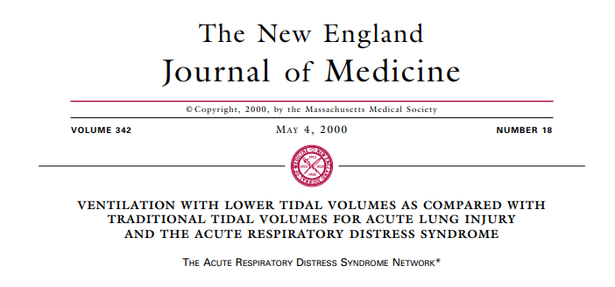
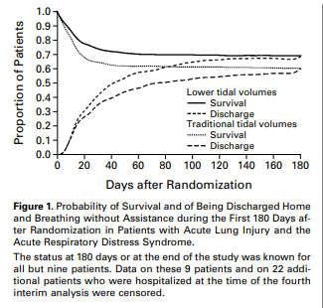

Slide 12
DEXA-ARDS
WHAT WAS THE QUESTION? (AIM)
  In patients with moderate-severe ARDS, does dexamethasone + routine care increase ventilator free days up to day 28
WHERE WAS IT DONE? (LOCATION)
  17 ICUs in Spain 2013-2018
WHO DID THEY CHOOSE? (INCLUSION/EXCLUSION)
  277 patients with ARDS (no pregnancy, lactation, brain death, DNAR, terminal disease, steroids, COPD/CCF)
WHAT DID THEY DO? (INTERVENTION/CONTROL)
  Dexamethasone immediately (and no later than 30hrs post ARDS) – 20mg IV from d1 to d5 and 10mg OD d6-d10
WHAT DID THEY SHOW? (OUTCOME)
  Number VFDs greater in dex group – 12.3 vs 7.5
  Secondary outcome – mortality 21% vs 36% - favours DEX, NNT 7

Slide 13
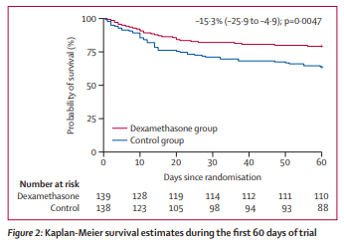

Slide 14
FACTT
WHAT WAS THE QUESTION? (AIM)
  Conservative vs liberal fluid strategy
WHERE WAS IT DONE? (LOCATION)
  20 US centres
WHO DID THEY CHOOSE? (INCLUSION/EXCLUSION)
  ARDS, PPV and the decision to insert a CVC. Excluded those who already had a PAC, ALI >48h, chronic conditions and those with a predicted 6mo mortality of >50%
WHAT DID THEY DO? (INTERVENTION/CONTROL)
  Fluids to a CVP <4 vs fluids to a CVP 10-14
WHAT DID THEY SHOW? (OUTCOME)
  Primary outcome favours conservative – mortality 25.5 vs 28.4% - but not statistically significant
  Secondary outcome – more ventilator free days in the conservative group, shorter duration ventilation, less heart failure and less delirium

Slide 15
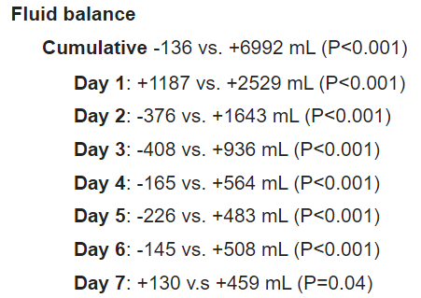
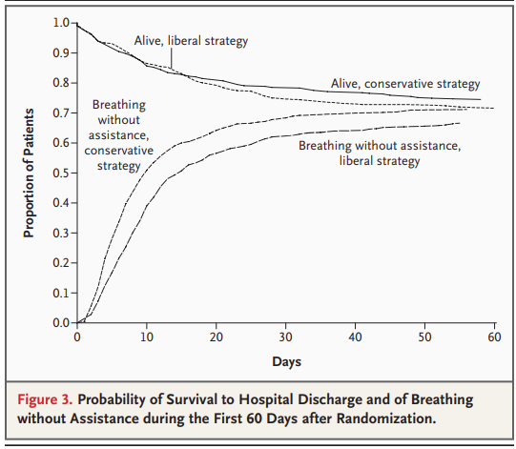

Slide 16
This is a brief break

Slide 17
ART
WHAT WAS THE QUESTION? (AIM)
  With severe ARDS – does recruitment plus PEEP titration to compliance vs conventional low PEEP decrease mortality?
WHERE WAS IT DONE? (LOCATION)
  120 ICUs, 9 countries (Arg/Bra/Col/It/Pol/Por/Mal/Spa/Uru), 2011-2017
WHO DID THEY CHOOSE? (INCLUSION/EXCLUSION)
  1013 patients, mod/severe ARDS<72h, exclude <18s, escalating vasopressors, PTX and similar, contraindications to hypercapnia
WHAT DID THEY DO? (INTERVENTION/CONTROL)
  SRM – see overleaf
WHAT DID THEY SHOW? (OUTCOME)
  277 deaths in intervention group, 251 in control group – trend continued at 6 months

Slide 18
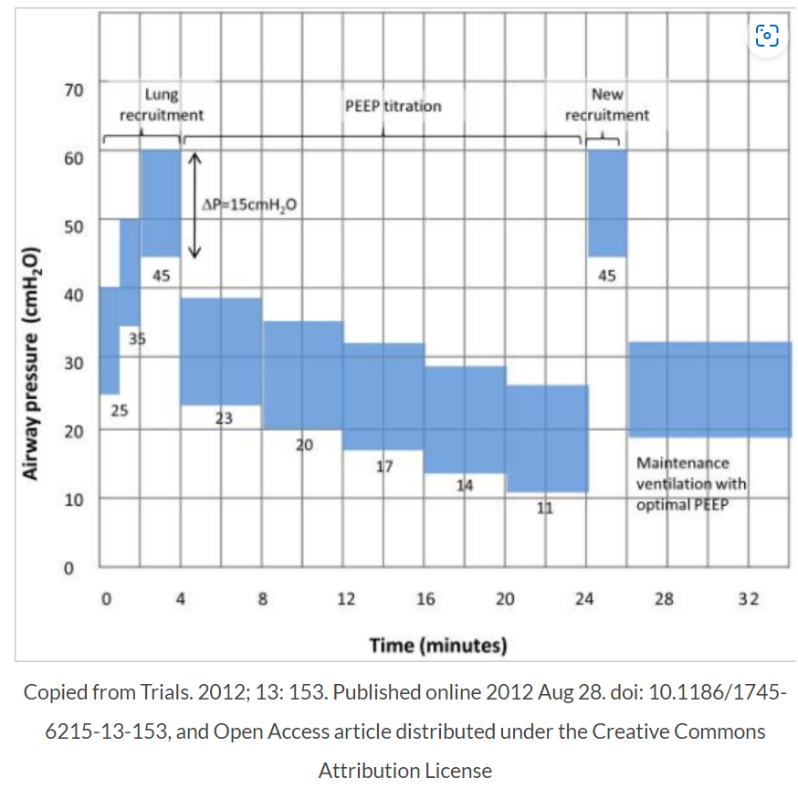

Slide 19
BILEVEL-APRV
WHAT WAS THE QUESTION? (AIM)
  Does APRV (vs conventional LTV ventilation) reduce duration of mechanical ventilation
WHERE WAS IT DONE? (LOCATION)
  Single centre RCT, Sichuan
WHO DID THEY CHOOSE? (INCLUSION/EXCLUSION)
  ARDS <48hrs, no refractory shock, ECMO, life expectancy <6mo, barotrauma, pregnancy, intracranial hypertension,
WHAT DID THEY DO? (INTERVENTION/CONTROL)
  APRV (Phigh at Pplat, Plow at 5, Tlow = 1-1.5TE and then adjusted so expiratory flow rate 50% PEFR). Release 10-14/min
WHAT DID THEY SHOW? (OUTCOME)
  Significant increase in ventilator free days in APRV arm

Slide 20
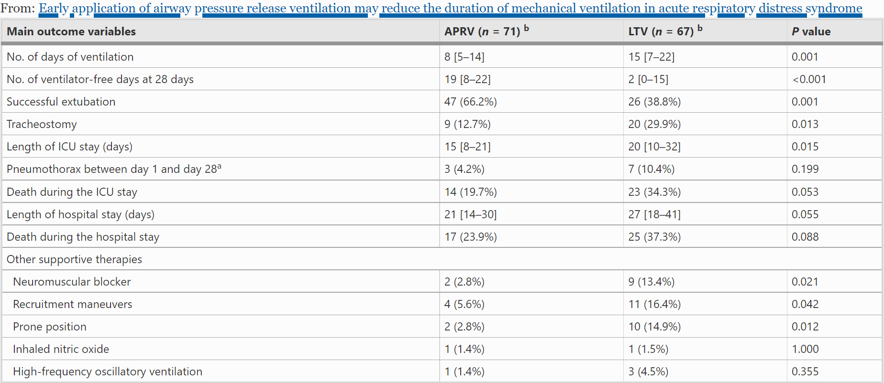

Slide 21
CESAR
WHAT WAS THE QUESTION? (AIM)
  Is ECMO beneficial in severe ARDS
WHERE WAS IT DONE? (LOCATION)
  UK units – 92 tertiary ICUs and 11 referral hospitals
WHO DID THEY CHOOSE? (INCLUSION/EXCLUSION)
  Severe but reversible ARDS (Murray >3), excluded ICH, vent >7d, contraindication for active treatment
WHAT DID THEY DO? (INTERVENTION/CONTROL)
  Transfer to ECMO centre – if stable – pressure release MV @30 and if no response in 12 hours - ECMO
WHAT DID THEY SHOW? (OUTCOME)
  Transferring patients with reversible ARDS, Murray score >3 and pH <7.2 is associated with reduced mortality

Slide 22
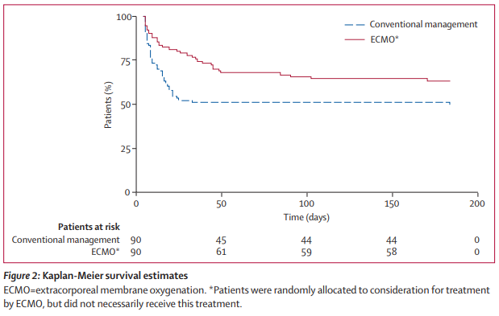

Slide 23
ACURASYS
WHAT WAS THE QUESTION? (AIM)
  Does early use of NMB improve mortality in mod/severe ARDS
WHERE WAS IT DONE? (LOCATION)
  20 ICUs in France
WHO DID THEY CHOOSE? (INCLUSION/EXCLUSION)
  339 patients – intubated with PF <180, 6-8ml/kg Vt, excluded pregnancy, those at end of life or recovering, children, already on NMBs
WHAT DID THEY DO? (INTERVENTION/CONTROL)
  Cisatracurium bolus then fixed rate infusion vs standard care (placebo)
WHAT DID THEY SHOW? (OUTCOME)
  90d adjusted mortality favoured cisatracurium – 31 vs 40.7

Slide 24
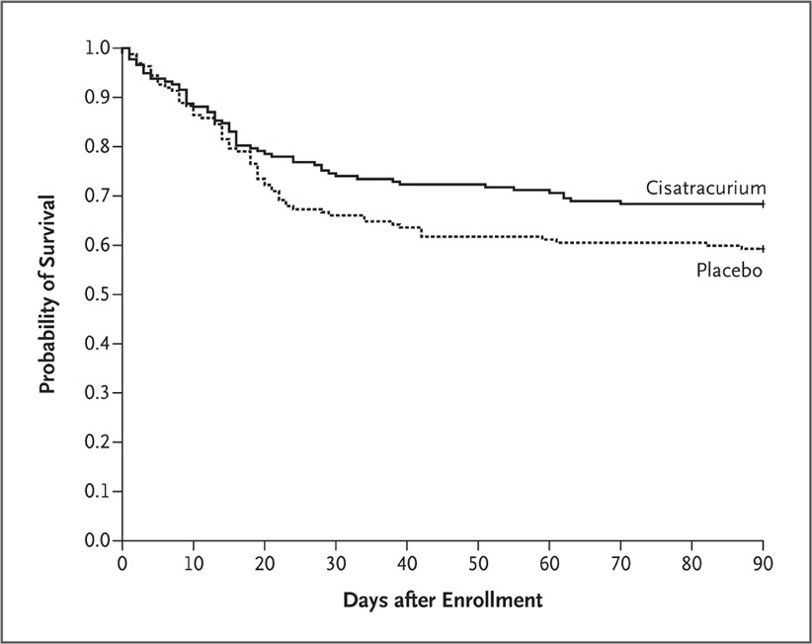

Slide 25
PROSEVA
WHAT WAS THE QUESTION? (AIM)
  Does proning reduce mortality in ARDS
WHERE WAS IT DONE? (LOCATION)
  26 units in France, 1 in Spain 466 patients
WHO DID THEY CHOOSE? (INCLUSION/EXCLUSION)
  Within 36hrs severe ARDS diagnosis – exclusions were contraindications to proning
WHAT DID THEY DO? (INTERVENTION/CONTROL)
  Proning for 16h up to 28d/until evidence improvement (average 4d)
WHAT DID THEY SHOW? (OUTCOME)
  28d mortality 16 vs 32%
  90d 24 vs 41% both favouring proning

Slide 26
